Slide 1
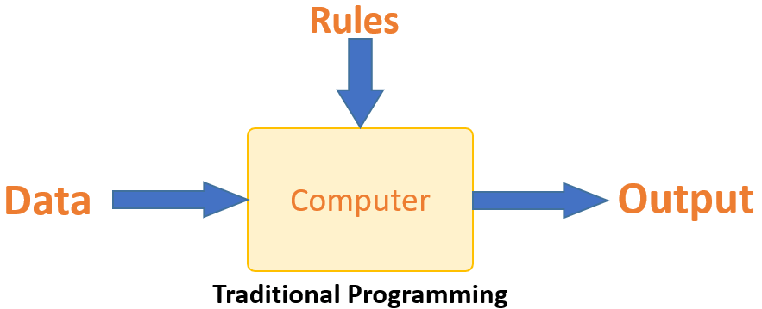
Machine Learning

Slide 2
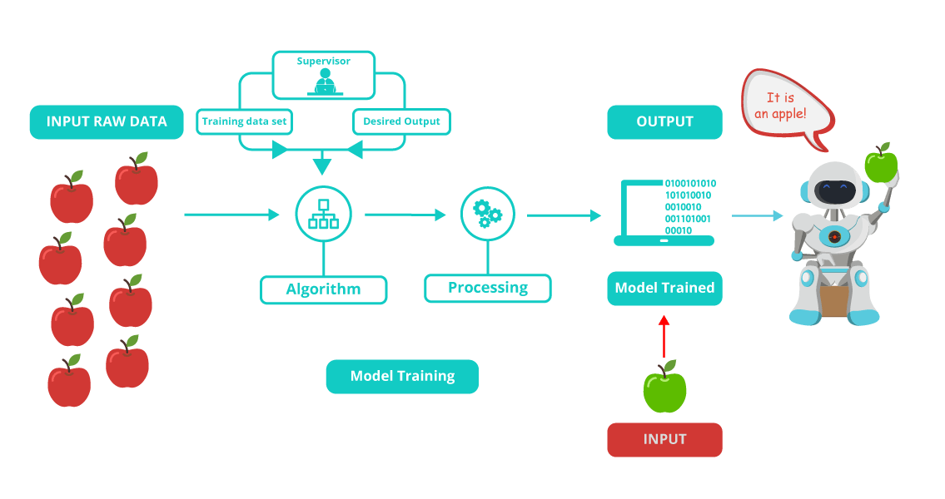
ML gives the computer that which makes it more similar to humans: The ability to learn.

Slide 3
Machine Learning
The field of machine learning is concerned that how to construct computer programs that automatically improve with experience.
A computer program is said to learn from experience E with respect to some class of tasks T and performance measure P, if its performance at tasks in T, as measured by P, improves with experience E.

Slide 4
In general, to have a well-defined learning problem, we must identity these three features:
class of tasks
measure of performance to be improved
source of experience.

Slide 5
A checkers learning problem:
Task T: playing checkers
Performance measure P: percent of games won against opponents
Training experience E: playing practice games against itself

Slide 6
A handwriting recognition learning problem:
Task T: ??
Performance measure P: ??
Training experience E: ??

Slide 7
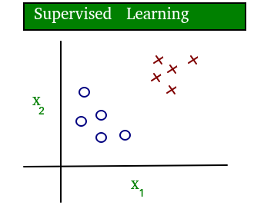
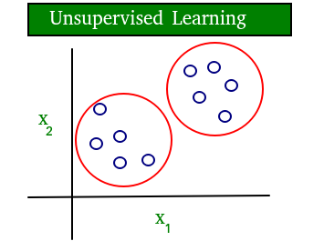
Types of machine learning problems
On the basis of Data(Experience):
Supervised Learning
Unsupervised Learning

Slide 8
Semi-supervised learning: Problems where you have a large amount of input data and only some of the data is labeled, are called semi-supervised learning problems. These problems sit in between both supervised and unsupervised learning. For example, a photo archive where only some of the images are labeled, (e.g. dog, cat, person) and the majority are unlabeled.

Slide 9
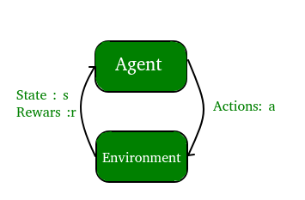
Reinforcement learning: In this learning, a computer program interacts with a dynamic environment to perform a certain task (such as driving a vehicle or playing a game against an opponent). The program is provided feedback in terms of rewards and punishments as it navigates its problem space.

